Slide 1
Office Checklist
Get speakers
Turn on talking hat
Tape it into hat
Get iphone5

Slide 2
Preclass Checklist
Play music
Tape down seat locations
Put up/out handouts
Set up bins
Get sorting hat accessible
Turn on sorting hat speakers and test
Turn on the projector
Run HashMap code (and make sure caffeine is on)
Test a few Shazam runs
Test out the presentation pointer
Make sure all code is loaded into QT and starter code is empty
Running: QT, Powerpoint, Ink2Go

Slide 3
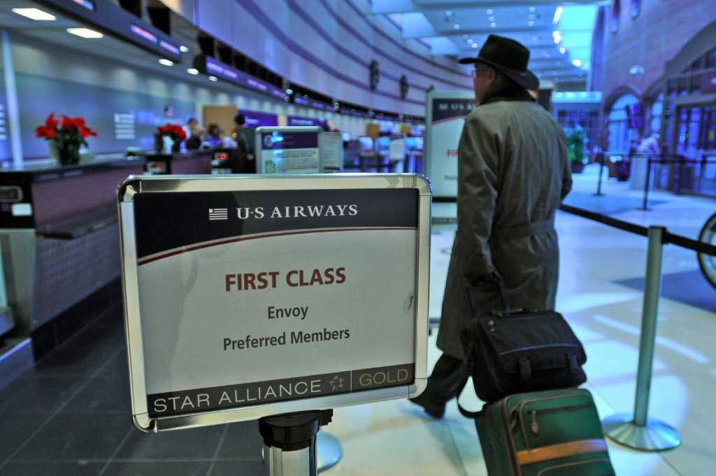
Announcement: PQ
Start
Feb 15nd
Due
Feb 24th

Slide 4
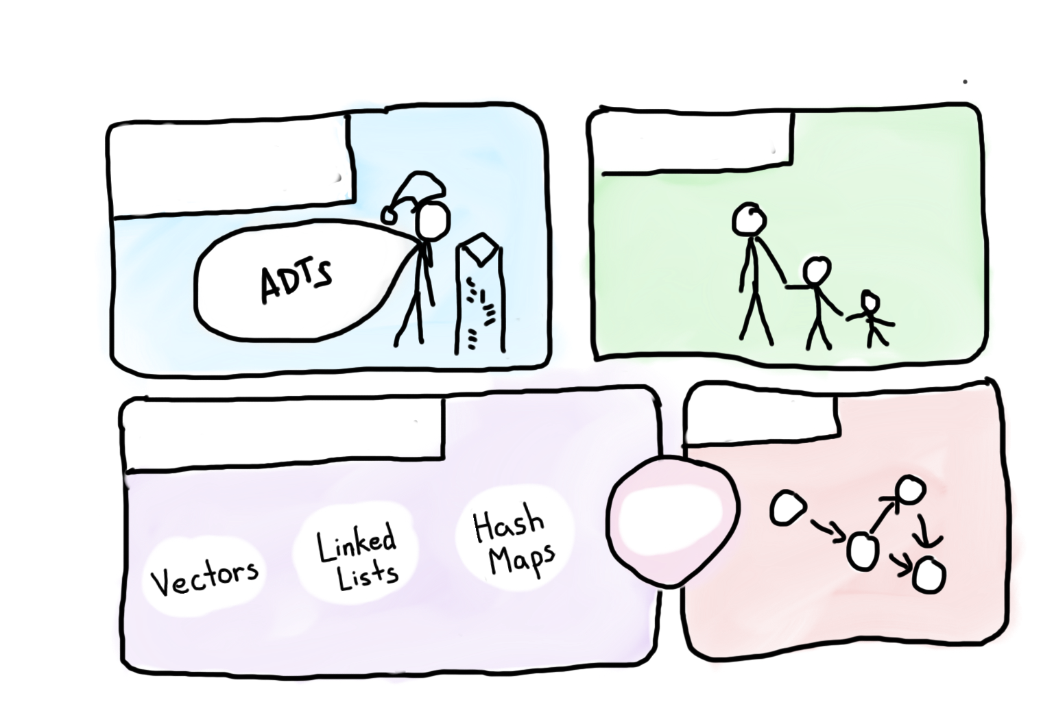
Programming Abstractions
Intro to Abstractions
Recursion
Graphs
Under the Hood
Trees

Slide 5


Programming Abstractions
Intro to Abstractions
Recursion
Graphs
Under the Hood
Trees
You are here

Slide 6
First, a cool program

Slide 7



Shazam
Source: Shazam

Slide 8
By the end of today I am going
to show you how this works.

Slide 9
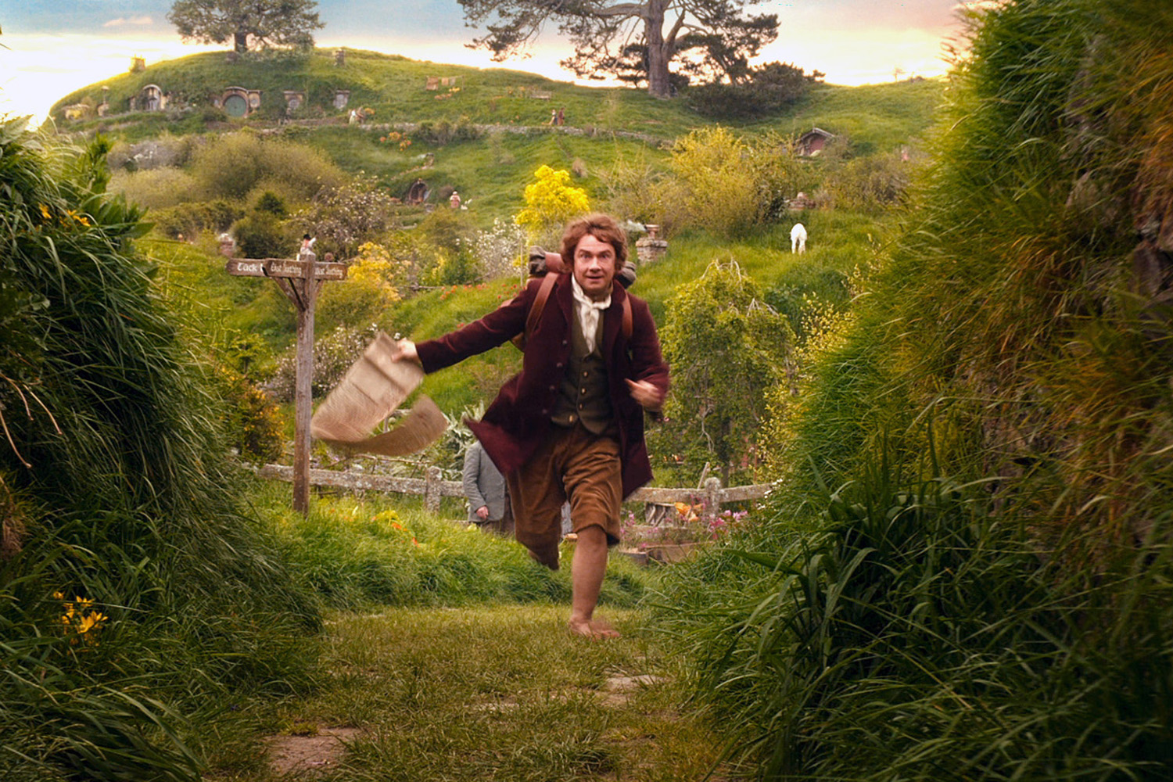
We’ve Gotten Ahead of Ourselves
Source: The Hobbit

Slide 10
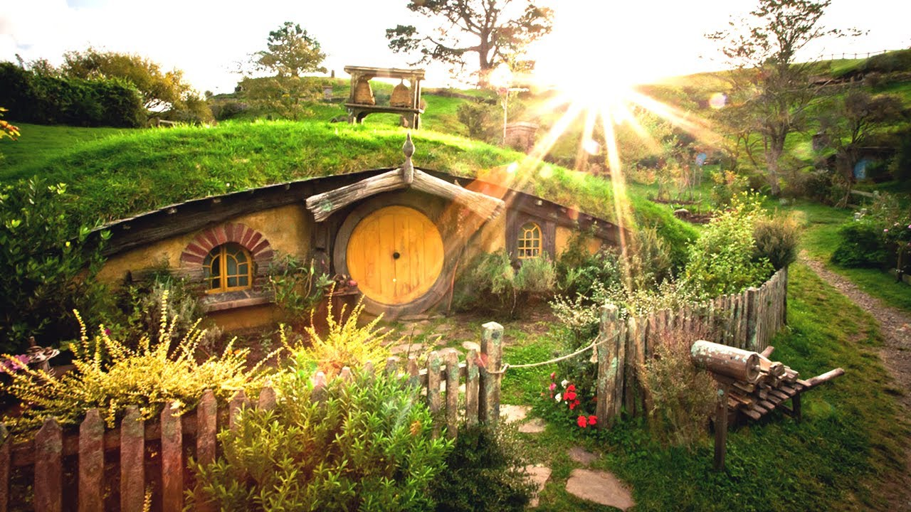
Start at the Beginning
Source: The Hobbit

Slide 11
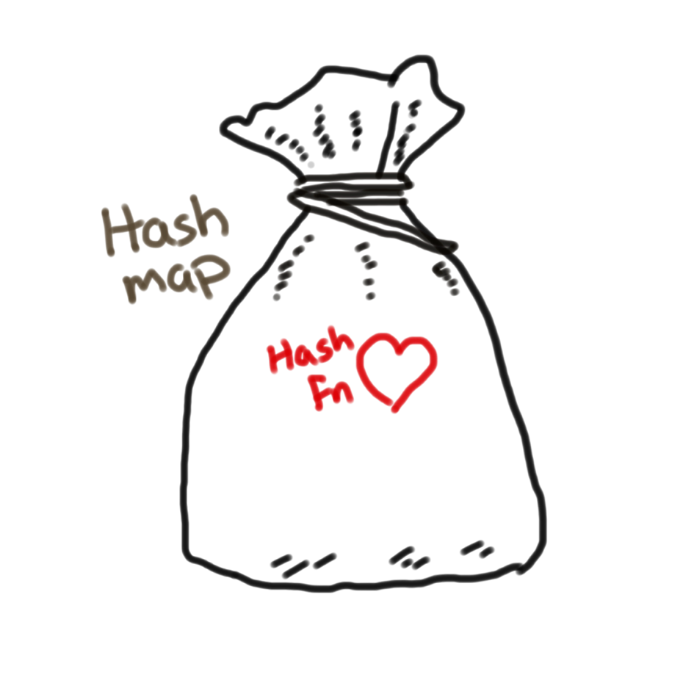
CS106B
Chris Piech
Hashing: The Heart of the Hash Map

Slide 12

Today’s Goals
Understand how the HashMap works
Add hashing to your algorithmic toolbox
Practice linked lists

Slide 13


Today’s Route
Other
Applications
(eg HashMap<string, string>)
Code
Real
Hash fns
Collisions
Hashing
HashMaps River

Slide 14

First Objective
(eg HashMap<string, string>)

Slide 15
Wikipedia API
// adds name / text pair to dataset
put(string articleName, string articleHTML)
// returns corresponding articleHTML
get(string articleName)
// removes the article
remove(string articleName)

Slide 16
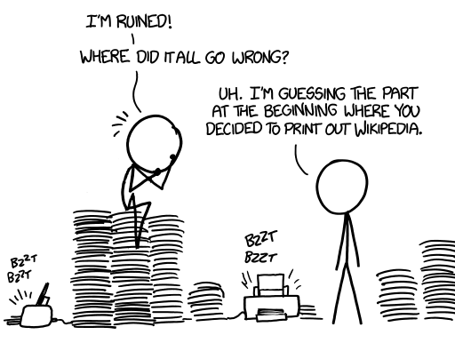
Wikipedia is big!
5 million articles and growing
Source: xkcd

Slide 17
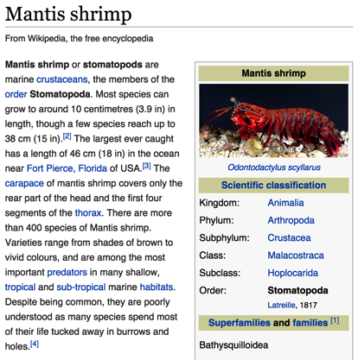
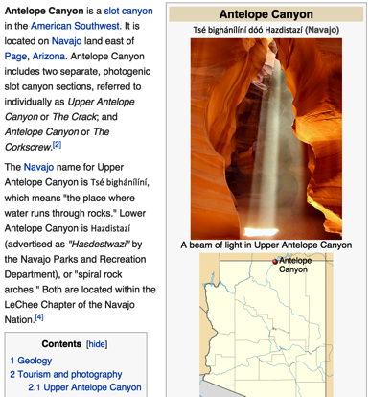
Key Value Pairs
Key = Title, Value = Article
Key:
Key:
“Mantis Shrimp”
“Antelope Canyon”
Value:
Value:

Slide 18
Key Value Pairs
Key = Title, Value = Article
Key:
Key:
“Mantis Shrimp”
“Antelope Canyon”
Value:
Value:
“<p><b>Mantis shrimp</b> or <b>stomatopods</b> are marine <a href="/wiki/Crustacean" title="Crustacean">crustaceans</a>, the members of the <a href="/wiki/Order_(biology)" title="Order (biology)">order</a> <b>Stomatopoda</b>. though a few species reach up to 38&#160;...”

Slide 19



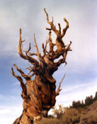
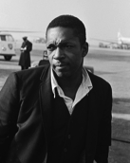
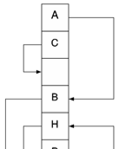
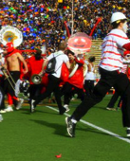
Thought Experiment
What if: we store articles in one gigantic vector
Wikipedia:
0
1
2
3
4
Antelope Canyon
Stanford Band
John Coltrane
Cuckoo Hashing
Methuselah

Slide 20

Thought Experiment
What if: we want to get(“Mantis shrimp”)?
Wikipedia:
0
1
2
3
4
Antelope Canyon
Stanford Band
John Coltrane
Cuckoo Hashing
Methuselah
Notes:
Look fo

Slide 21
Thought Experiment
What if: we want to get(“Mantis shrimp”)?
Wikipedia:
0
1
2
3
4
Antelope Canyon
Stanford Band
John Coltrane
Cuckoo Hashing
Methuselah

Slide 22
Thought Experiment
What if: we want to get(“Mantis shrimp”)?
Wikipedia:
0
1
2
3
4
Antelope Canyon
Stanford Band
John Coltrane
Cuckoo Hashing
Methuselah

Slide 23
Thought Experiment
What if: we want to get(“Mantis shrimp”)?
Wikipedia:
0
1
2
3
4
Antelope Canyon
Stanford Band
John Coltrane
Cuckoo Hashing
Methuselah

Slide 24
Thought Experiment
What if: we want to get(“Mantis shrimp”)?
Wikipedia:
0
1
2
3
4
Antelope Canyon
Stanford Band
John Coltrane
Cuckoo Hashing
Methuselah

Slide 25
Has to be a better way!

Slide 26
What if: there was a way to know where our article belonged just by looking at the title?

Slide 27
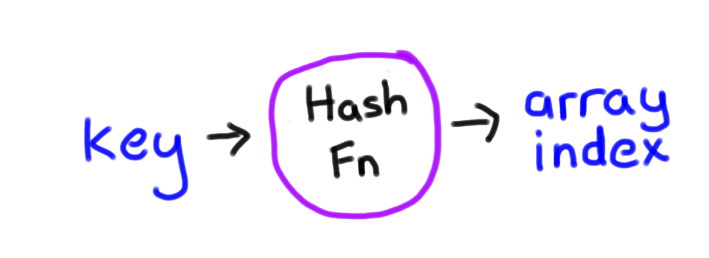
Hash Function
int hash(string key);
Notes:
That’s the idea of hashing. A hash function is one that takes in a key and returns back an index into an array.

Slide 28
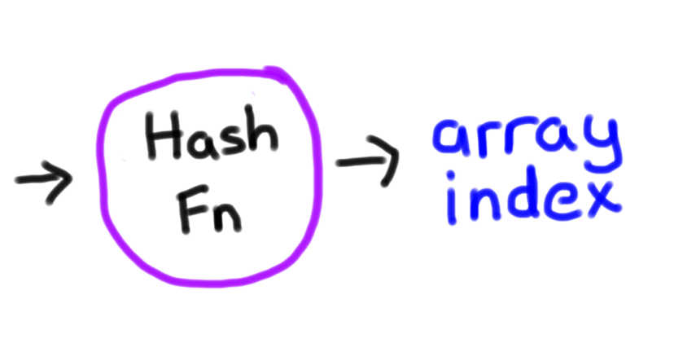
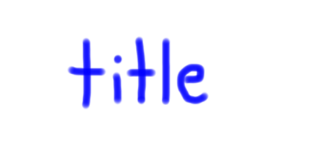
Hash Function
int hash(string title);
Notes:
That’s the idea of hashing. A hash function is one that takes in a key and returns back an index into an array.

Slide 29

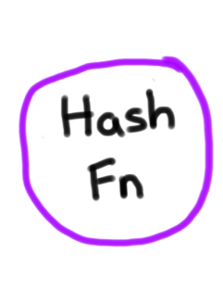
Wikipedia with Hashing
Wikipedia:
39
40
41
42
43

Slide 30
put(“mantis shrimp”, html)
Wikipedia:
39
40
41
42
43

Slide 31
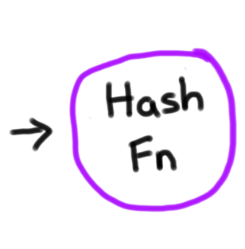
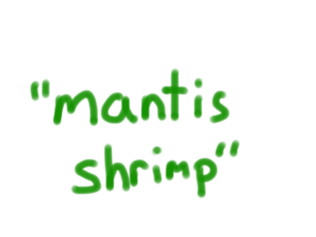
put(“mantis shrimp”, html)
Wikipedia:
39
40
41
42
43

Slide 32
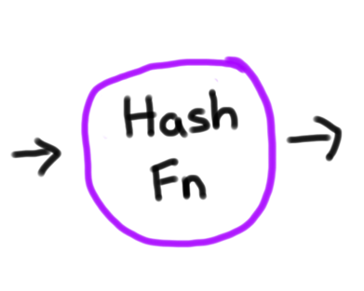
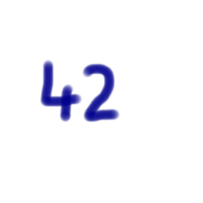
put(“mantis shrimp”, html)
Wikipedia:
39
40
41
42
43

Slide 33
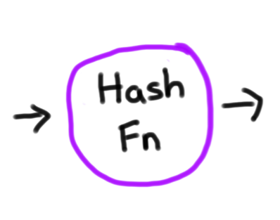
put(“mantis shrimp”, html)
Wikipedia:
39
40
41
42
43

Slide 34
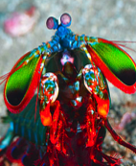
put(“mantis shrimp”, html)
Wikipedia:
39
40
41
42
43
Mantis shrimp

Slide 35
Wonderful!

Slide 36
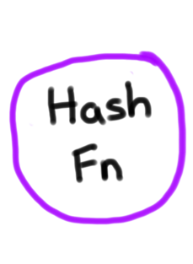
get(“mantis shrimp”)
Wikipedia:
39
40
41
42
43
Mantis shrimp

Slide 37

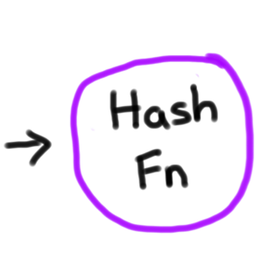
get(“mantis shrimp”)
Wikipedia:
39
40
41
42
43
Mantis shrimp

Slide 38
get(“mantis shrimp”)
Wikipedia:
39
40
41
42
43
Mantis shrimp

Slide 39
get(“mantis shrimp”)
Wikipedia:
39
40
41
42
43
Mantis shrimp

Slide 40
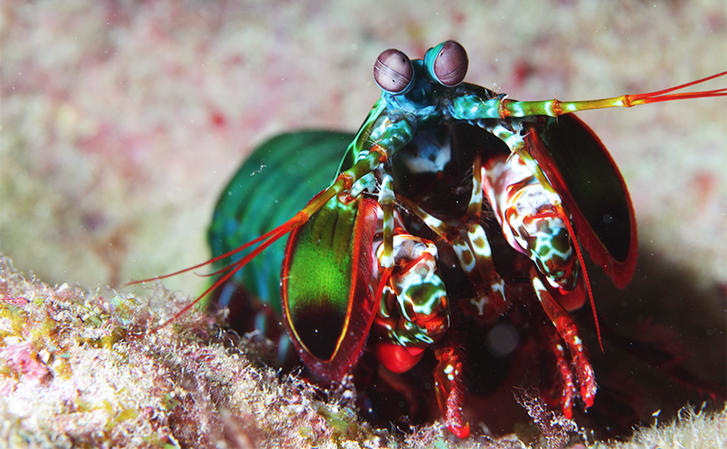
Source: Planet Animal Zone

Slide 41
Notes:
So far I have told you about a hash function. And it was pretty magical. Let’s dig a little deeper.

Slide 42
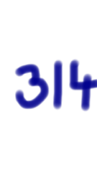

Property #1: Consistent
If you pass in the same input, you will always get the same index.

Slide 43
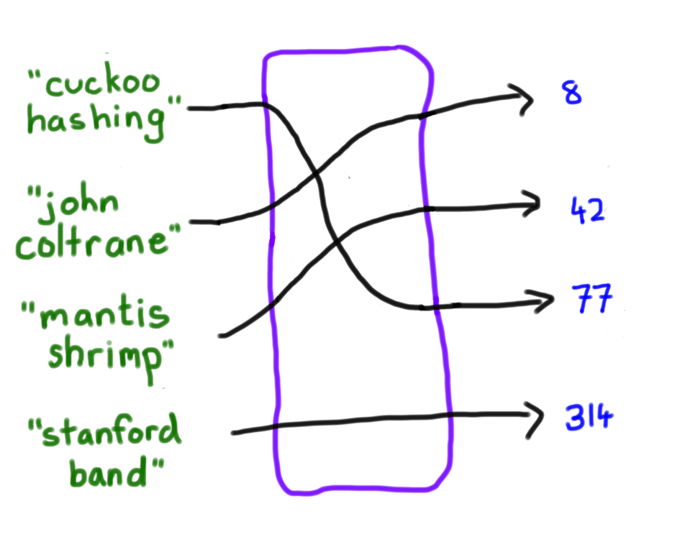
Property #2: Well Distributed
If you pass in the different inputs, a hash function will return different indices as often as possible.
Hash Fn

Slide 44
Does one exist?

Slide 45
What Does a Hash Fn Look Like?
You have already seen one!
int hash(string key) {
int name0 = alpha(key[0]);
int name1 = alpha(key[1])’
int preHash = name0 + 7 * name1;
return preHash % NUM_BUCKETS;
}

Slide 46

Volunteer

Slide 47
Today’s Route
Other
Applications
(eg HashMap<string, string>)
Code
Wikipedia
Real
Hash fns
Collisions
Hashing
HashMaps River

Slide 48
Today’s Route
Other
Applications
(eg HashMap<string, string>)
Code
Wikipedia
Real
Hash fns
Collisions
Hashing
HashMaps River

Slide 49
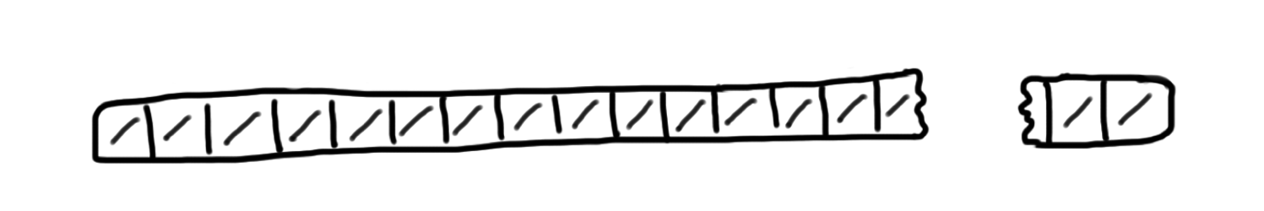
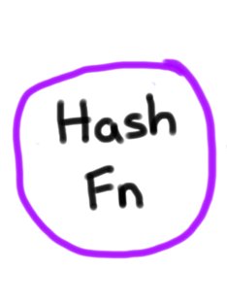
HashMap
Wikipedia:
7
8
9
10
11
12
13
14
49,999
0
1
2
3
4
5
6

Slide 50
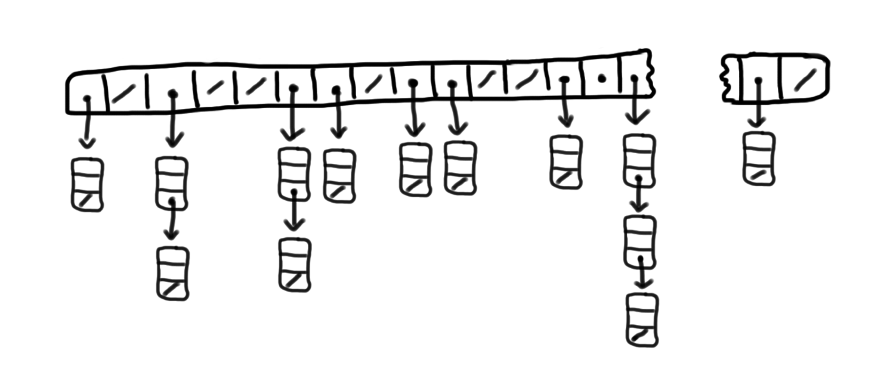
HashMap
Wikipedia:
7
8
9
10
11
12
13
14
49,999
0
1
2
3
4
5
6

Slide 51
Our old friend, linked lists!

Slide 52

HashMap
Wikipedia:
7
8
9
10
11
12
13
14
49,999
0
1
2
3
4
5
6
Article:
Key
Value
Next

Slide 53
HashMap
Wikipedia:
7
8
9
10
11
12
13
14
49,999
0
1
2
3
4
5
6

Slide 54
get(“Antelope Canyon”)
Wikipedia:
7
8
9
10
11
12
13
14
49,999
0
1
2
3
4
5
6

Slide 55
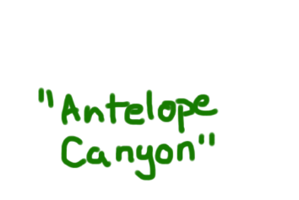
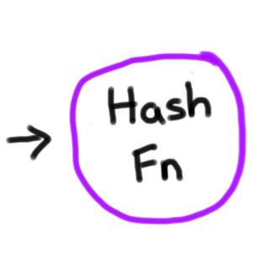
get(“Antelope Canyon”)
Wikipedia:
7
8
9
10
11
12
13
14
49,999
0
1
2
3
4
5
6

Slide 56
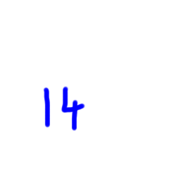
get(“Antelope Canyon”)
Wikipedia:
7
8
9
10
11
12
13
14
49,999
0
1
2
3
4
5
6

Slide 57

get(“Antelope Canyon”)
Wikipedia:
7
8
9
10
11
12
13
14
49,999
0
1
2
3
4
5
6

Slide 58
get(“Antelope Canyon”)
Wikipedia:
7
8
9
10
11
12
13
14
49,999
0
1
2
3
4
5
6

Slide 59
get(“Antelope Canyon”)
Wikipedia:
7
8
9
10
11
12
13
14
49,999
0
1
2
3
4
5
6

Slide 60

get(“Antelope Canyon”)
Wikipedia:
7
8
9
10
11
12
13
14
49,999
0
1
2
3
4
5
6

Slide 61

Photo Credit: Alex Mironyuk

Slide 62
HashMap
Wikipedia:
7
8
9
10
11
12
13
14
49,999
0
1
2
3
4
5
6

Slide 63
put(“John Coltrane”, html)
Wikipedia:
7
8
9
10
11
12
13
14
49,999
0
1
2
3
4
5
6

Slide 64
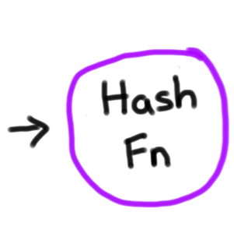
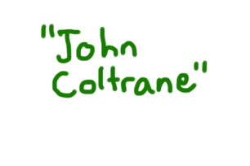
put(“John Coltrane”, html)
Wikipedia:
7
8
9
10
11
12
13
14
49,999
0
1
2
3
4
5
6

Slide 65

put(“John Coltrane”, html)
Wikipedia:
7
8
9
10
11
12
13
14
49,999
0
1
2
3
4
5
6

Slide 66
put(“John Coltrane”, html)
Wikipedia:
7
8
9
10
11
12
13
14
49,999
0
1
2
3
4
5
6

Slide 67
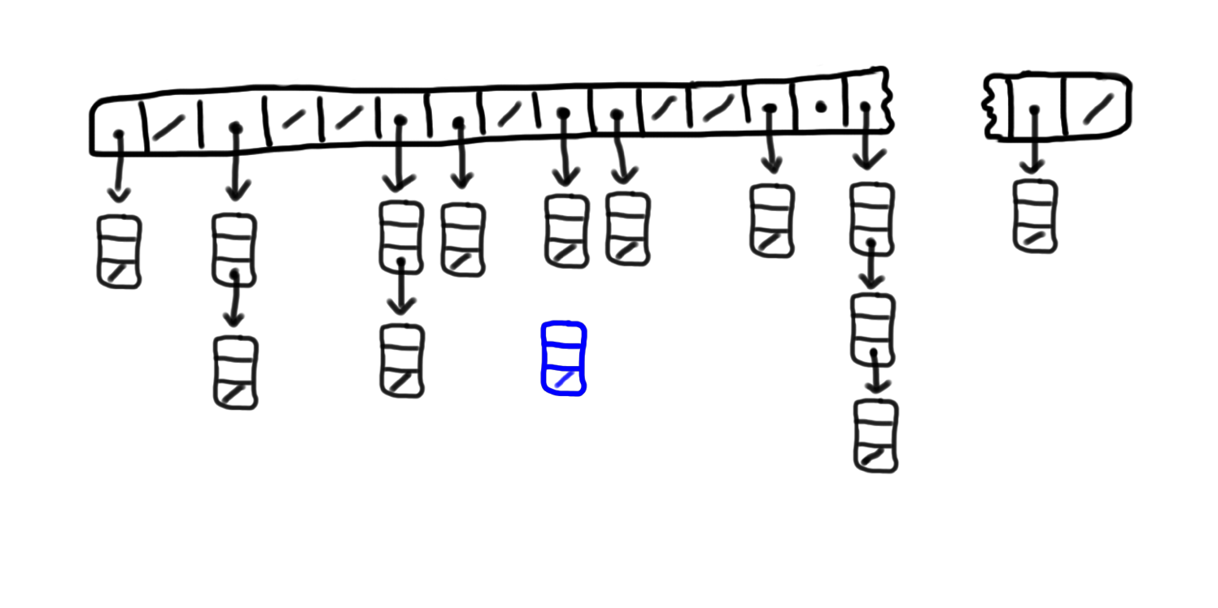
put(“John Coltrane”, html)
Wikipedia:
7
8
9
10
11
12
13
14
49,999
0
1
2
3
4
5
6
Notes:
Why the front?!

Slide 68

put(“John Coltrane”, html)
Wikipedia:
7
8
9
10
11
12
13
14
49,999
0
1
2
3
4
5
6

Slide 69
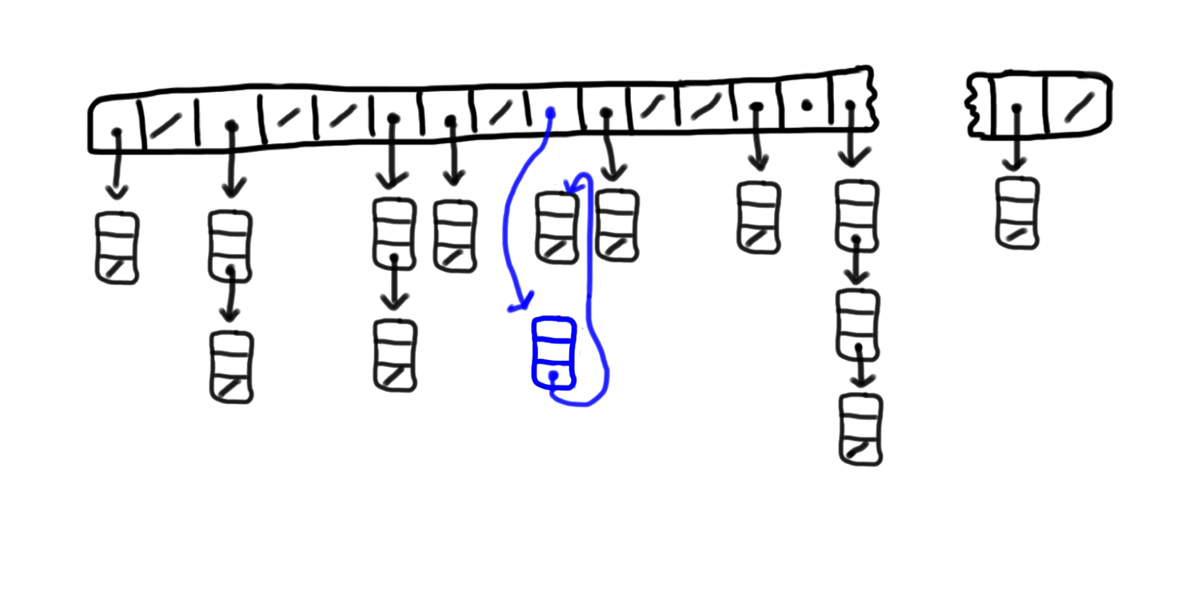
put(“John Coltrane”, html)
Wikipedia:
7
8
9
10
11
12
13
14
49,999
0
1
2
3
4
5
6

Slide 70
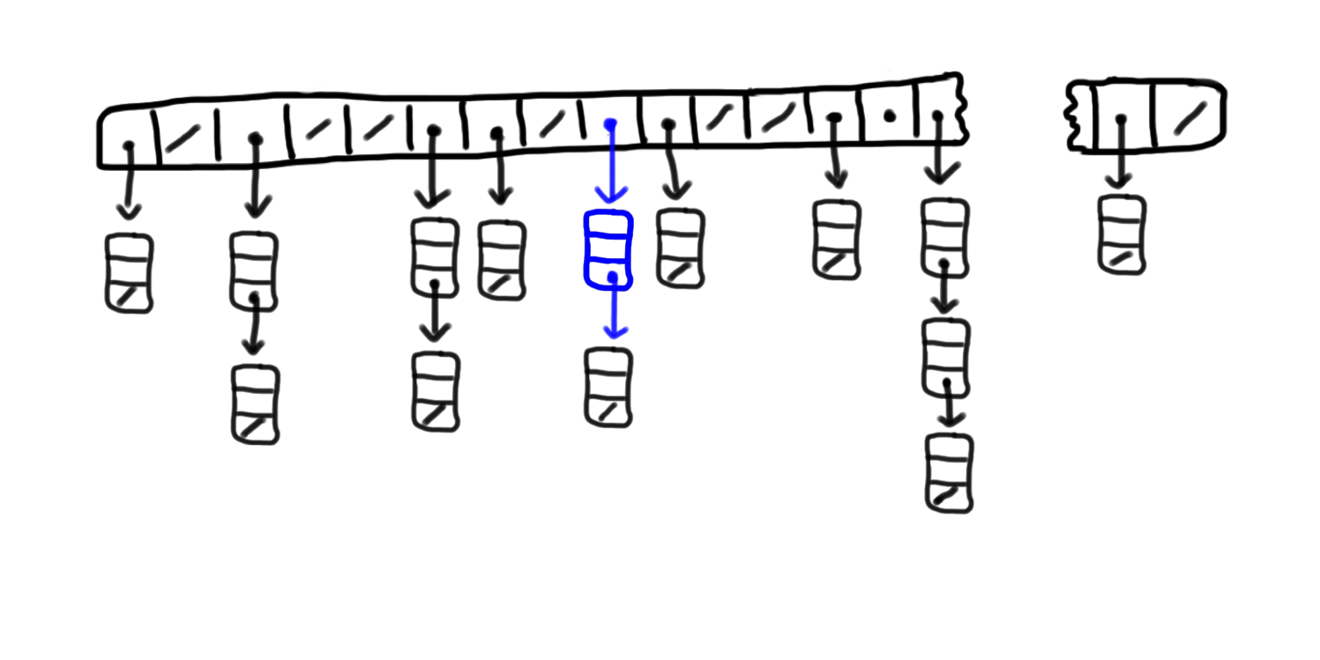

put(“John Coltrane”, html)
Wikipedia:
7
8
9
10
11
12
13
14
49,999
0
1
2
3
4
5
6

Slide 71
HashMap Algorithm Summary
Initialization:
0. Make a large array of linked lists
Getting and Setting:
Hash: key -> bucketIndex.
Jump directly to the bucket head.
Run linear search over the short list.

Slide 72
Today’s Route
Other
Applications
(eg HashMap<string, string>)
Code
Wikipedia
Real
Hash fns
Collisions
Hashing
HashMaps River

Slide 73
Today’s Route
Other
Applications
(eg HashMap<string, string>)
Code
Wikipedia
Real
Hash fns
Collisions
Hashing
HashMaps River

Slide 74

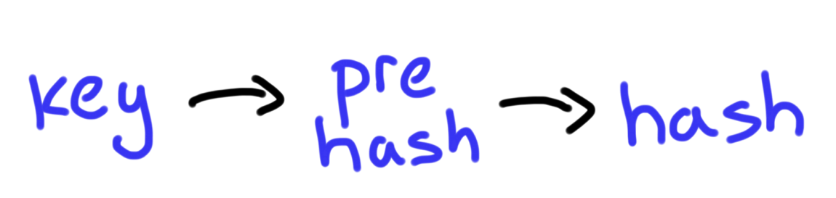
Hash Function
Use % operator
In range [0, max)
Generate a really large
(positive) number

Slide 75
Judge Strings by the Contents of their Characters
preHash = Add each character in a string
preHash = Add each character in a string, weighted by 31^{i}
Each pixel is one bucket in our array
50,000 wikipedia articles
0
2
4
1
3
>= 5
Number of collisions

Slide 76
The Java Hash
Given string a as a key.
prehash =
return (prehash % numBuckets)
* In java, the weights are in reverse order. That is not important :).

Slide 77
Why 31?

Slide 78
What if it was 2?
Bucket distribution of 50,000 article titles
from Wikipedia

Slide 79
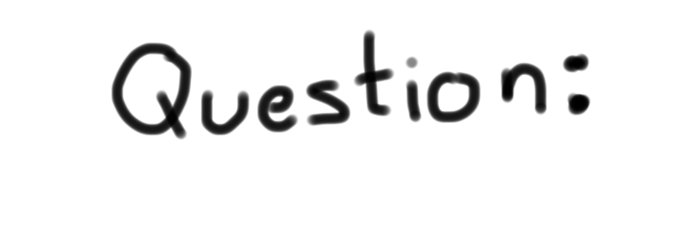
What is the big-O of the get method?

Slide 81
[suspense]

Slide 82

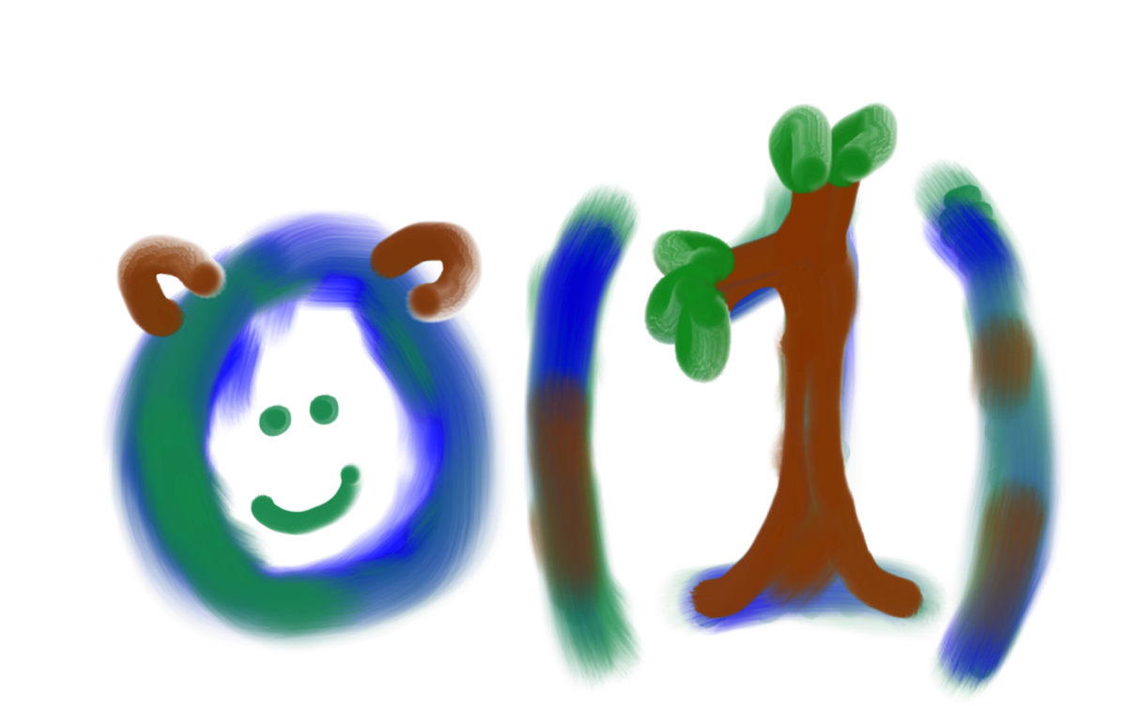
* In expectation

Slide 83
What if nBuckets is too small?!?

Slide 84
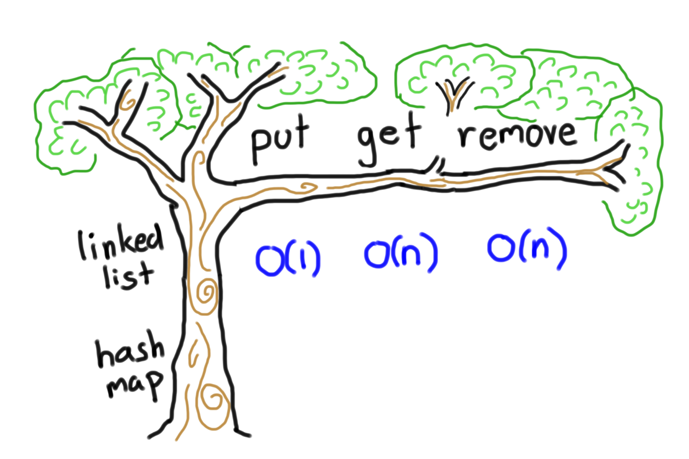
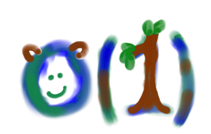
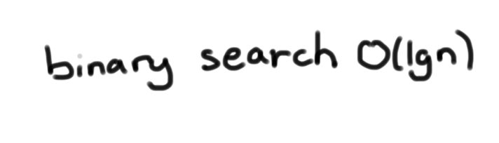
HashMap Big-O

Slide 85


Slide 86
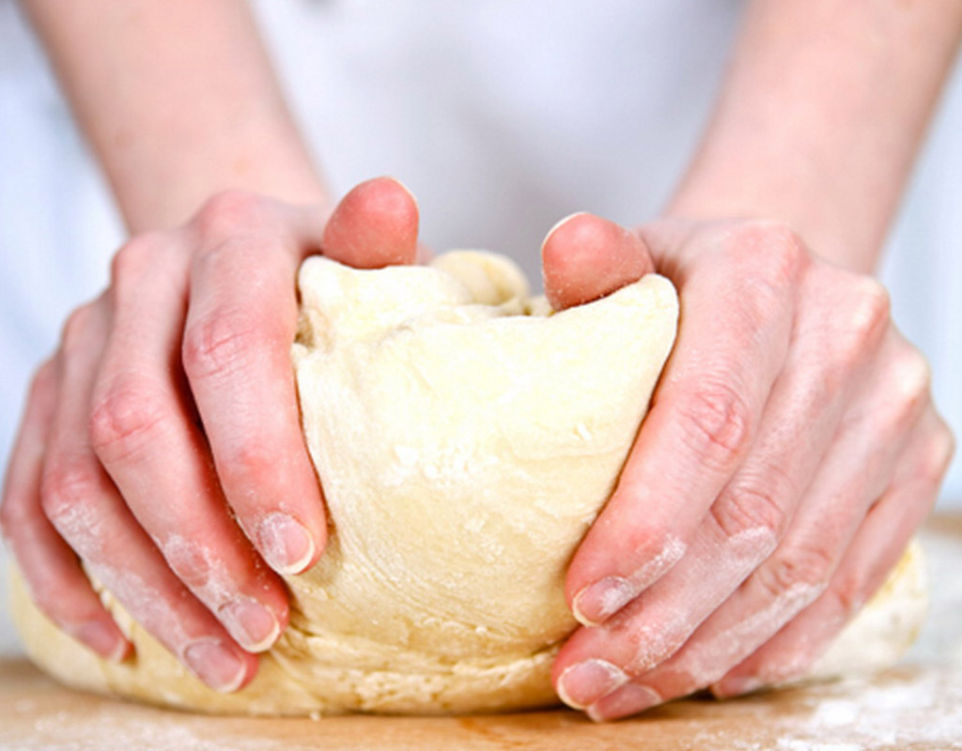
Knead to Program It
Source: timescity

Slide 87
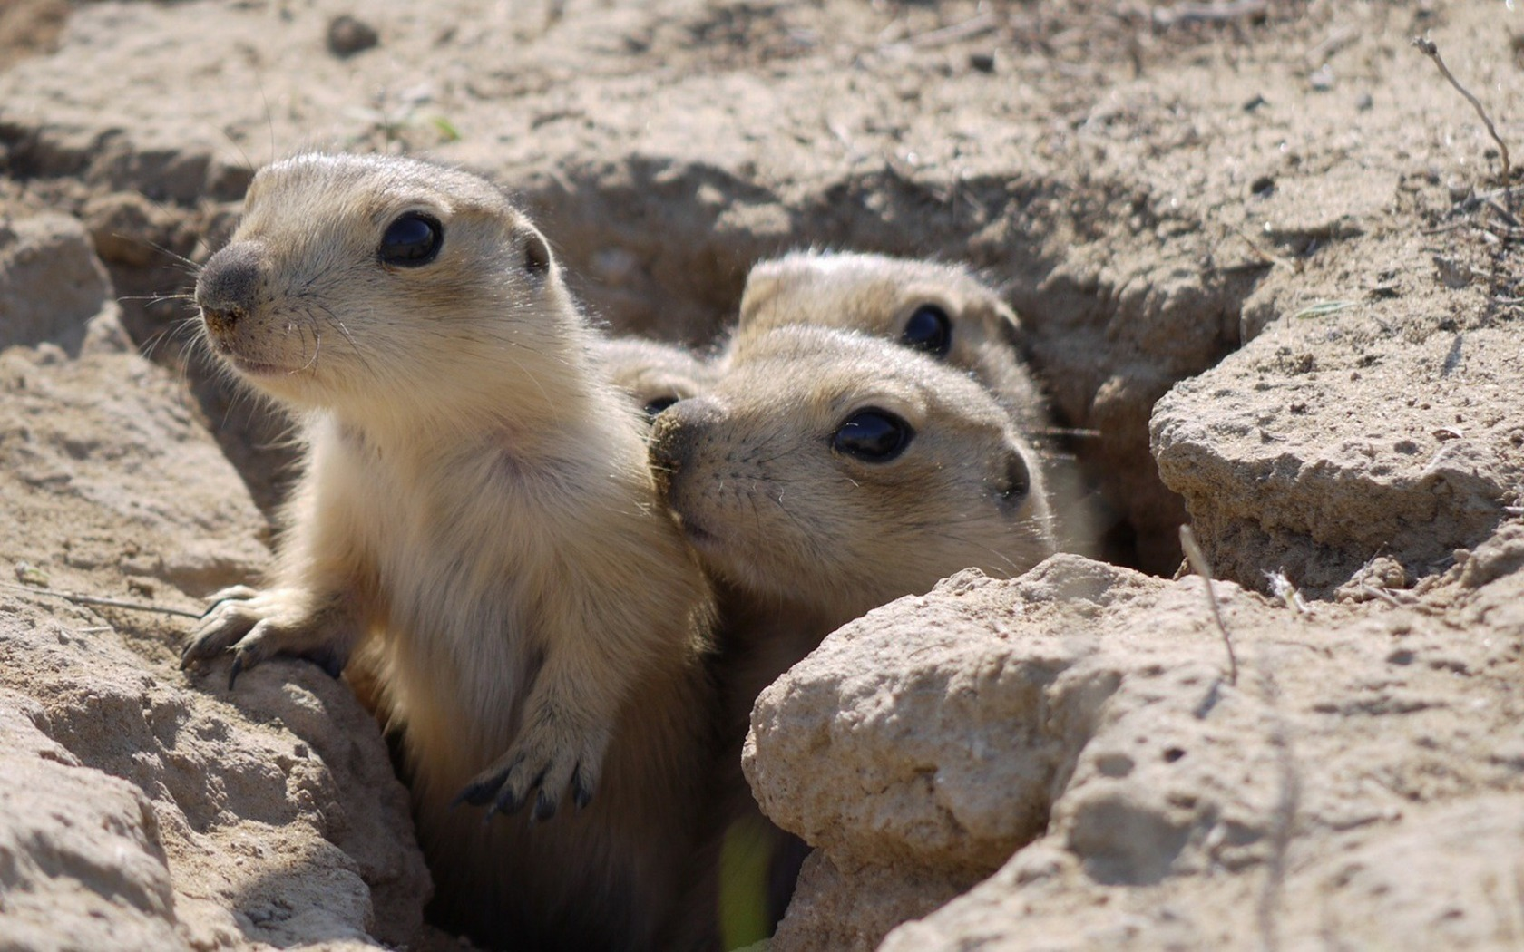
Gopher It
Source: Planet Animal Zone

Slide 89
Today’s Route
Other
Applications
(eg HashMap<string, string>)
Code
Wikipedia
Real
Hash fns
Collisions
Hashing
HashMaps River
Notes:
Check out the .h file. Explain Article **
Look at findArticle in the .cpp file. Think about it.
Write contains
Write put
Write get
Write hash as sum of chars (get int overflow problem)

Slide 90

Today’s Route
Other
Applications
(eg HashMap<string, string>)
Code
Wikipedia
Real
Hash fns
Collisions
Hashing
HashMaps River

Slide 91
Today’s Route
Other
Applications
(eg HashMap<string, string>)
Code
Wikipedia
Real
Hash fns
Collisions
Hashing
HashMaps River

Slide 92
And Here We Are

Slide 93
Shazam
Source: Shazam

Slide 94

Source: Steve Depenport
Notes:
Not Magic, Science!

Slide 95
Similar to Wikipedia:
Huge search problem.

Slide 96
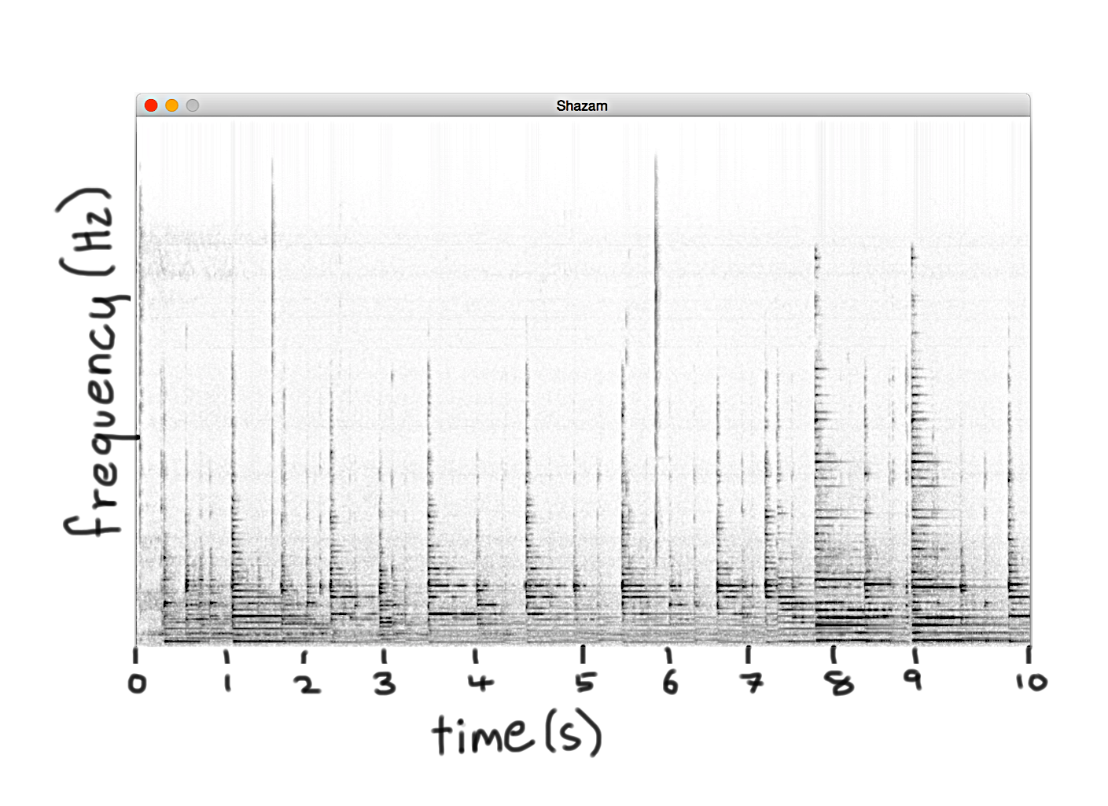
Spectrogram
Does anyone recognize this song?

Slide 97

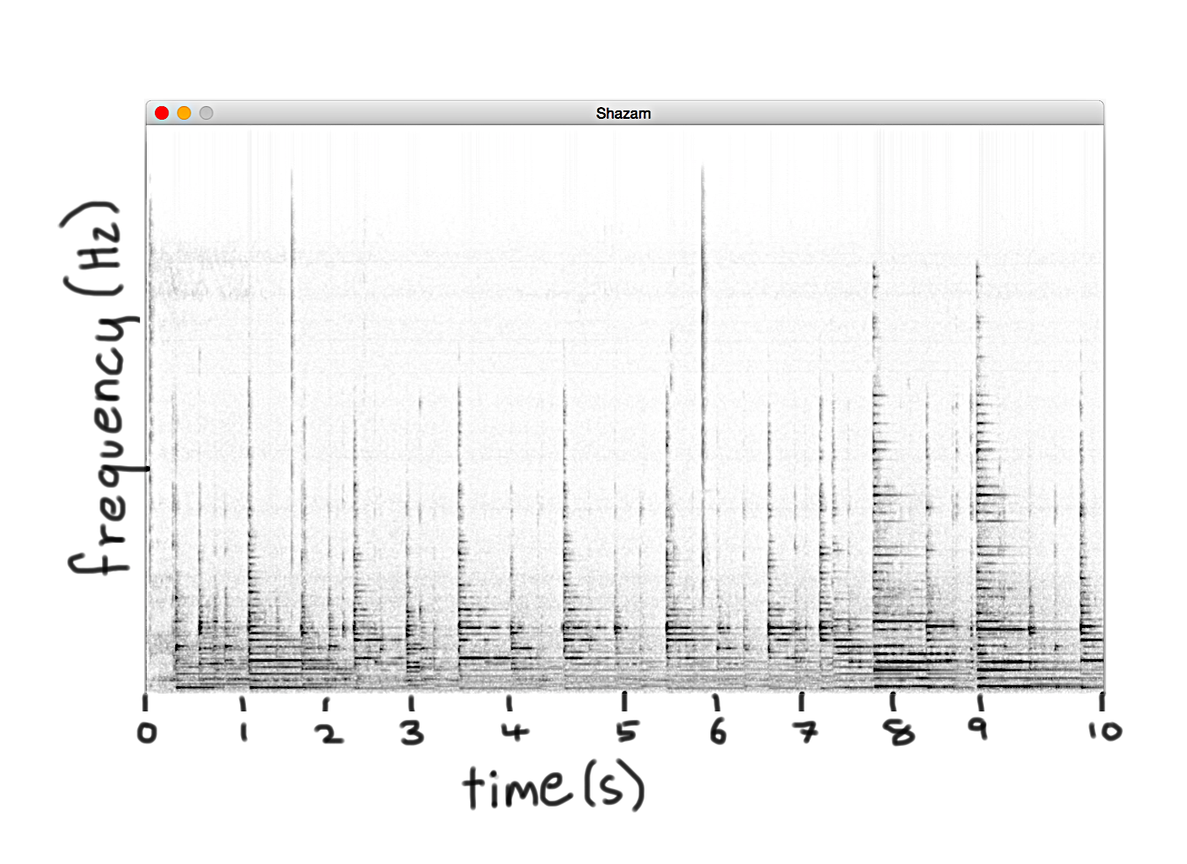



Spectrogram
Does anyone recognize this song?

Slide 98
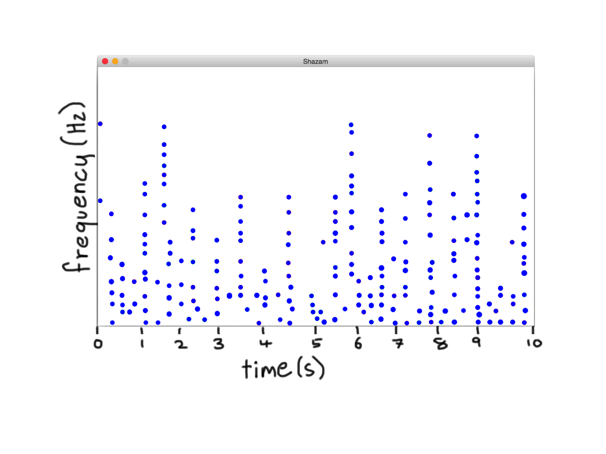
Notes Over Time
Wang, A. An Industrial-Strength Audio Search Algorithm

Slide 99
Hash the whole thing?

Slide 100
No

Slide 101

Find Pairs of Notes
Wang, A. An Industrial-Strength Audio Search Algorithm

Slide 102
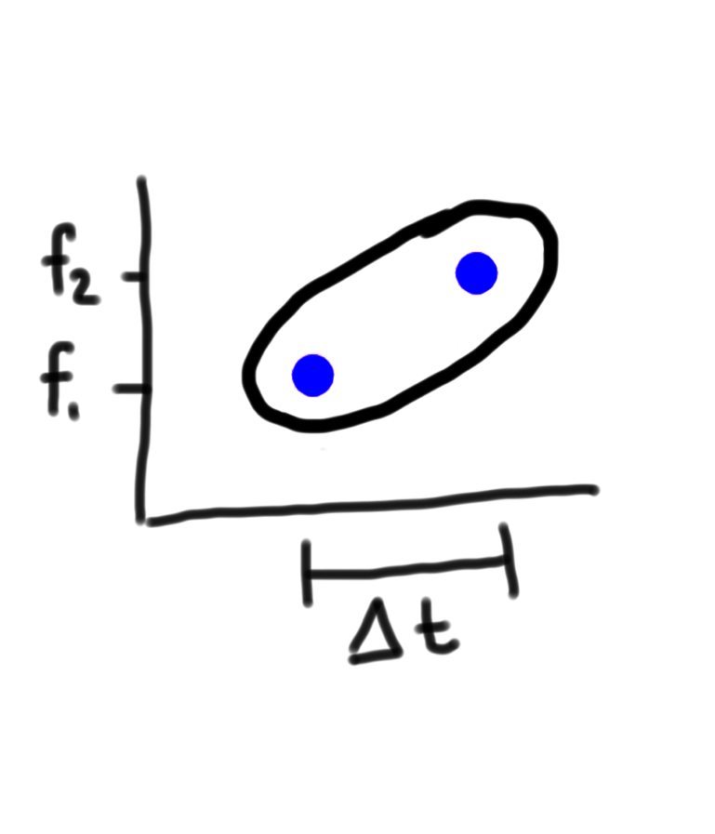
Note Pairs
Wang, A. An Industrial-Strength Audio Search Algorithm

Slide 103

Note/Songs Map
Shazam
Wikipedia
Key:
Key:
“Antelope Canyon”
Value:
Value:
You Can Call Me Al – Paul Simon. 7s,
You Can Call Me Al – Paul Simon. 43s,
All Right Now – Police. 18s
Wang, A. An Industrial-Strength Audio Search Algorithm

Slide 104


Note Pair Hashing

Slide 105


Note Pair Hashing

Slide 106

Note Pair Hashing
Window for n

Slide 107

Note Pair Hashing

Slide 108
Note Pair Hashing

Slide 109
Note Pair Hashing

Slide 110
Note Pair Hashing

Slide 111
Note Pair Hashing

Slide 112

Hashing Note Pairs
int hash(int f1, int f2, int timeDelta) {
int p = 31;
int pre = f1 + (p * f2) + (p * p * timeDelta);
return pre % NUM_BUCKETS;
}
You Can Call Me Al – Paul Simon. 23s,
You Can Call Me Al – Paul Simon. 54s,
Message in a Bottle – Police. 92s
Wang, A. An Industrial-Strength Audio Search Algorithm
Notes:
97 million songs. About 200 seconds per song and about 30 pairs per second. 5.8 trillion pairs

Slide 113
Code Available

Slide 114
Review

Slide 115
HashMap Algorithm Summary
Initialization:
0. Make a large array of linked lists
Getting and Setting:
Hash: key -> bucketIndex.
Jump directly to the bucket head.
Run simple search over the list.

Slide 116





Hash Function
int hash(string key);
1. Consistent
2. Well Distributed
Hash Fn

Slide 117
Today’s Goals
Understand how the HashMap works
Add hashing to your algorithmic toolbox
Practice linked lists

Slide 118

Today’s Goals
Understand how the HashMap works
Add hashing to your algorithmic toolbox
Practice linked lists

Slide 119


Place and Time
N Andy, P Chris, J Huang, L Guibas. Scalable Homework Search for Massive Open Online Programming Courses. WWW, Seoul 2014.

Slide 120
Friday Trees
Intro to Abstractions
Recursion
Graphs
Under the Hood
Trees
You will be here

Slide 121
Thank you

Slide 122


Modern Times

Slide 123
Midterm
77
Perfects
Median = 86
Maybe a few things to review
Doing great
Some more serious review
Looking like trouble

Slide 124
Details
Midterm
Review Policy
Answer Key

